Slide 1
Numerical investigation of two-dimensional Mode-II delamination in composite laminates
Congzhe Wang, Anastasios P. Vassilopoulos, Thomas Keller
Ecole Polytechnique Fédérale de Lausanne

Slide 2
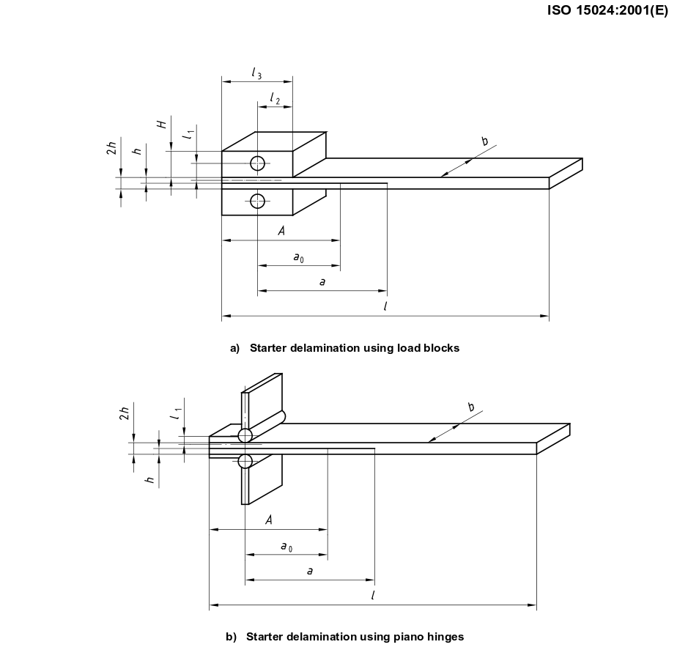
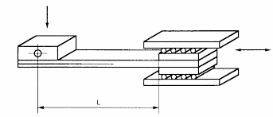
Mode I: DCB
Limited information
Certain areas of application
Mode II: ELS
Standardized tests

Slide 3

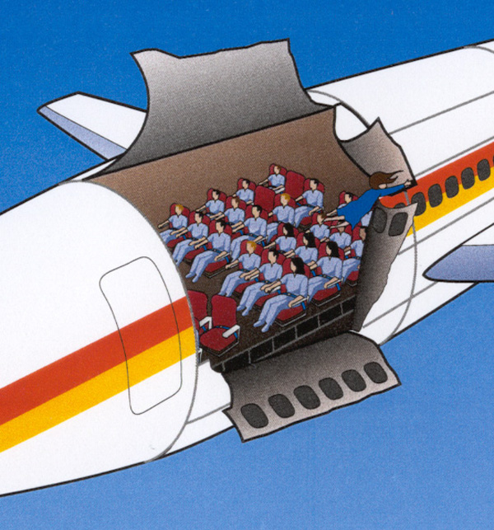

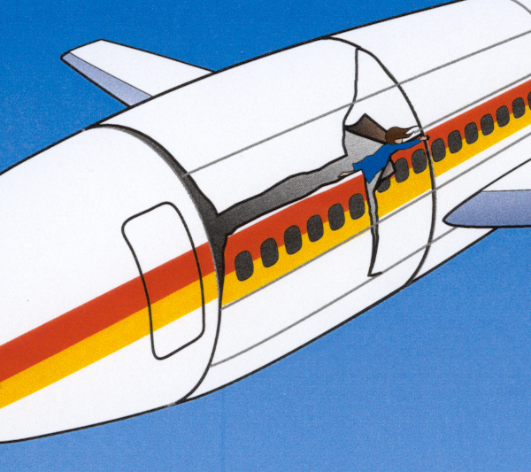
The ALOHA Airlines flight 243 (1988)

Slide 4

The ALOHA Airlines flight 243 (1988)
https://www.youtube.com/watch?v=YYa7Fq5Ec6c

Slide 5

Engineering for a sustainable future
Application areas

Slide 6
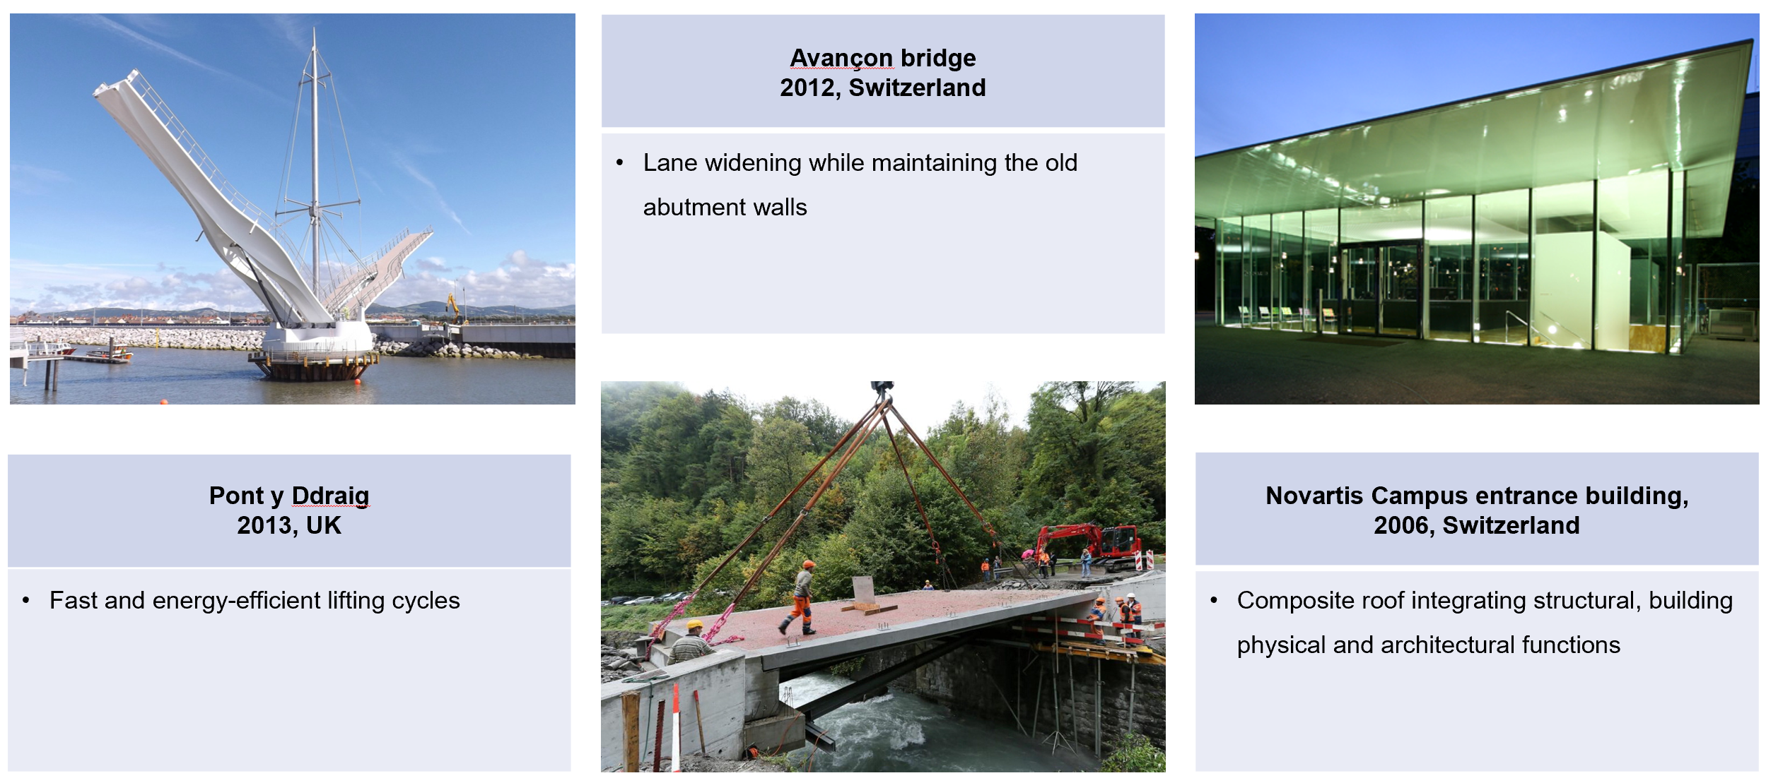
Composite constructions in Europe

Slide 7
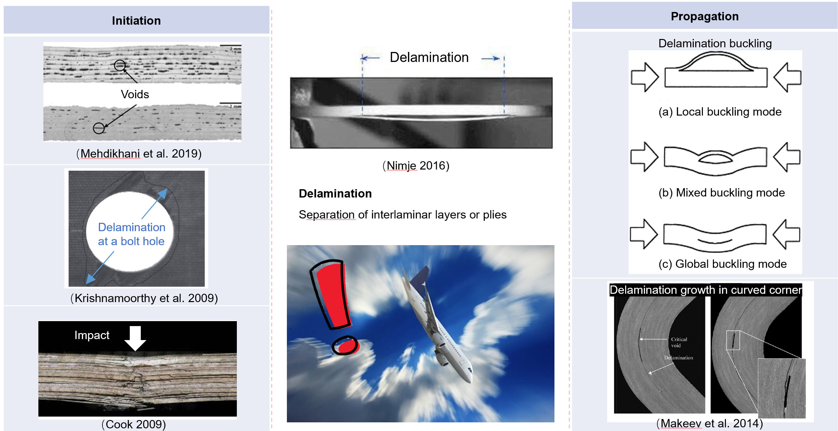
Delamination in composites – 1D/2D/3D

Slide 8
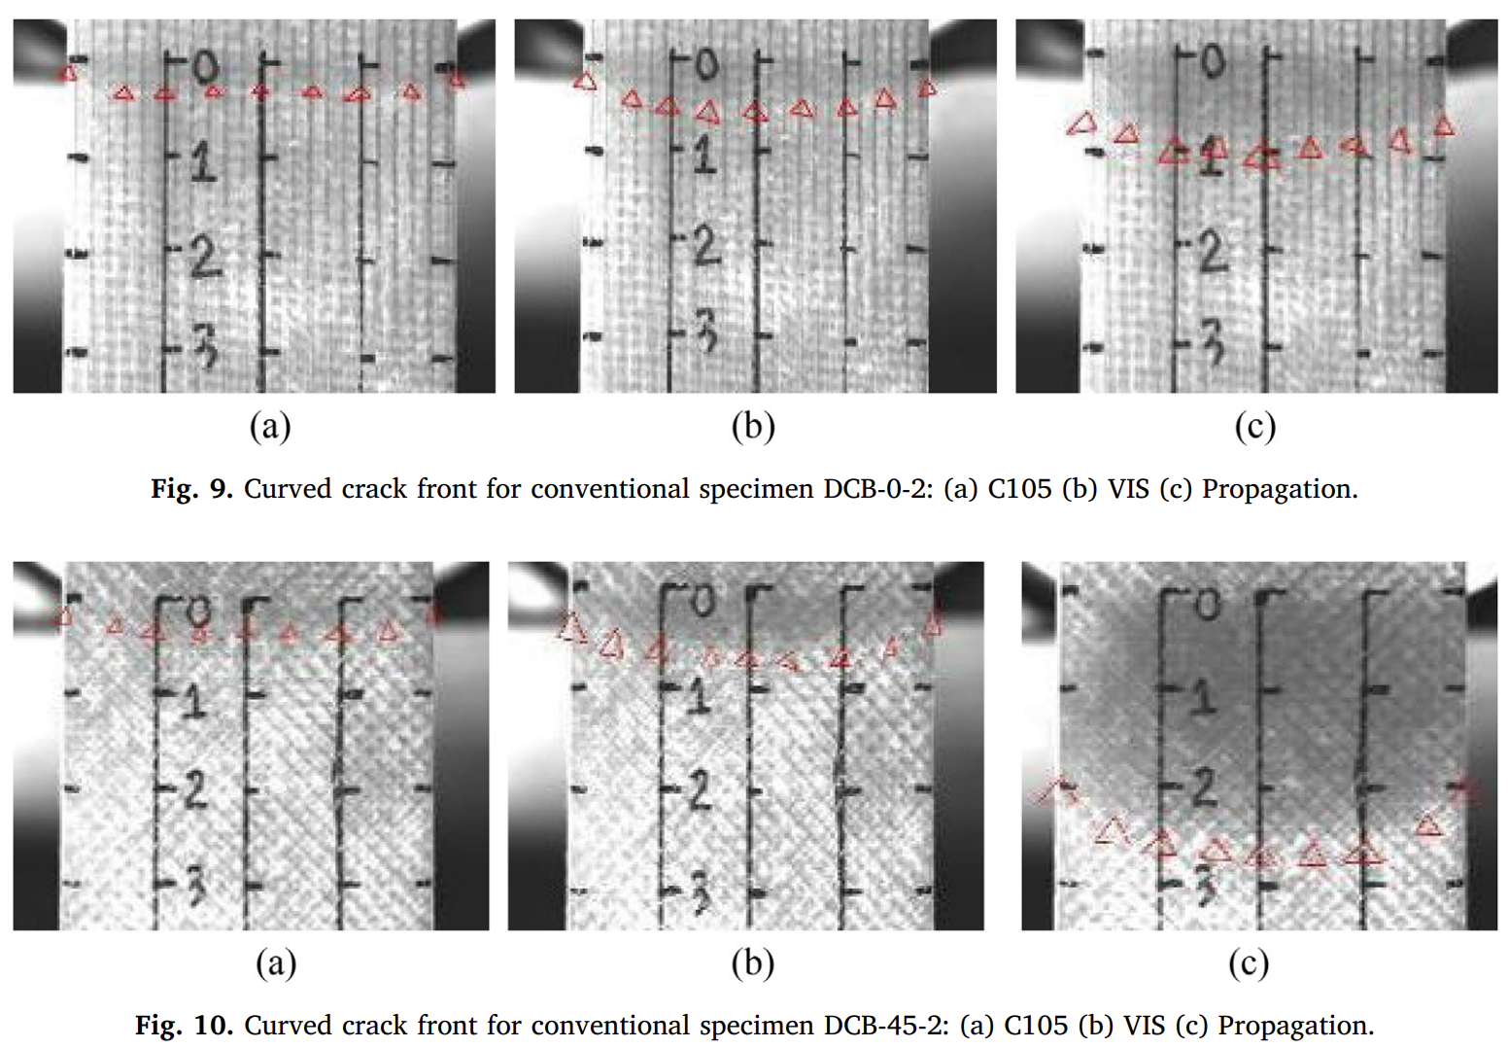
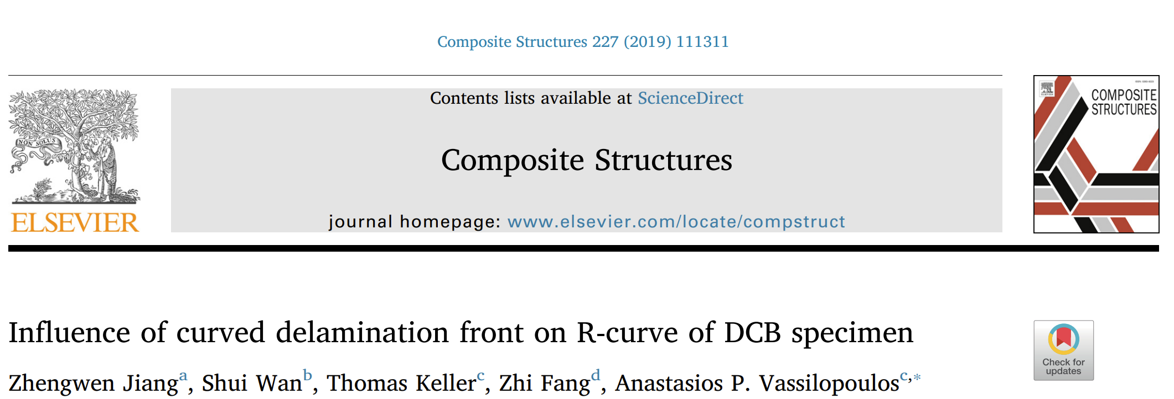
Crack front is (almost) never straight (?)

Slide 9
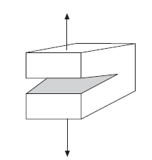
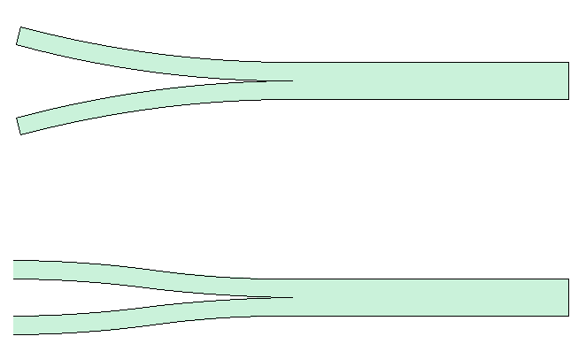
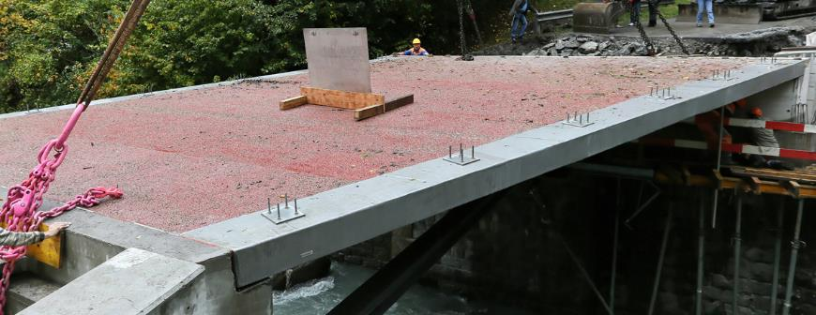
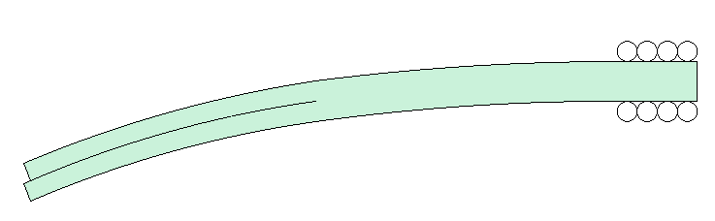
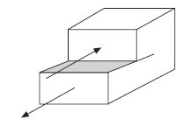
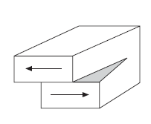
Traditional fracture analysis?
P
P
ISO 15024:2001 – Double cantilever beam (DCB) test
Mode I (opening)
Decomposition
P
Delamination
ISO 15114:2014 – End-loaded split (ELS) test
Mode II (sliding shear)
Delamination in real structures
One-dimensional (1D) crack propagation
Constant crack width (beam width)
Free boundary at cracked ends
Two-dimensional (2D) crack propagation
Mode III (tearing shear)
?

Slide 10
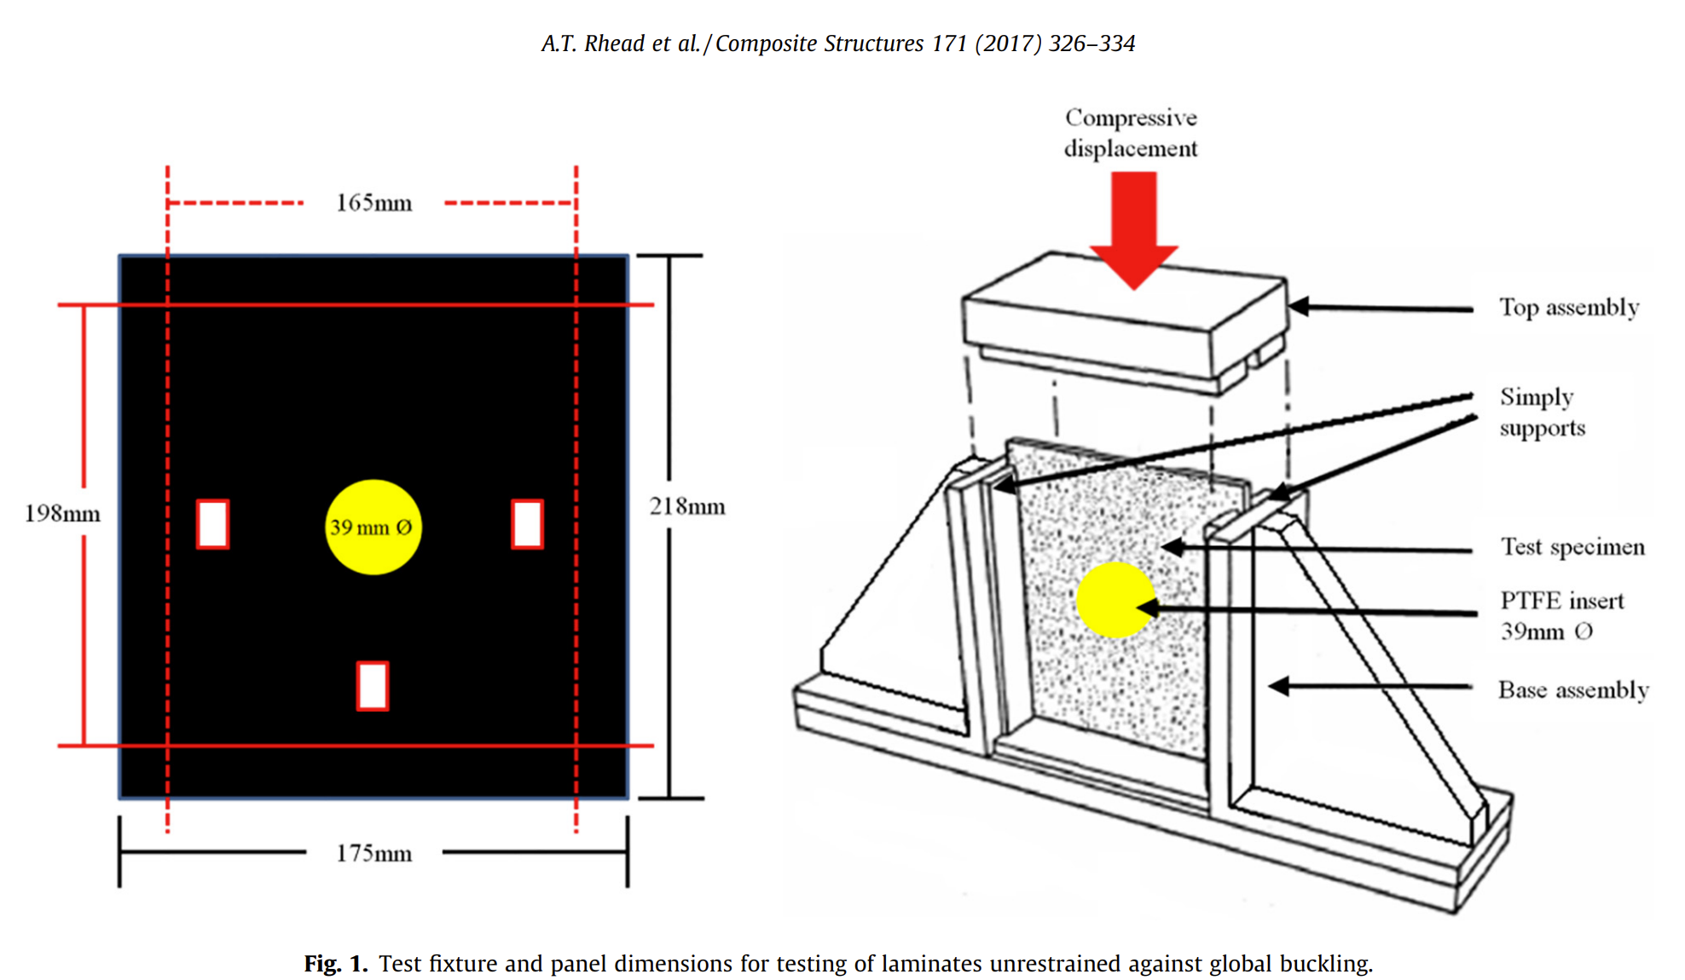
In the past… panels with central hole

Slide 11
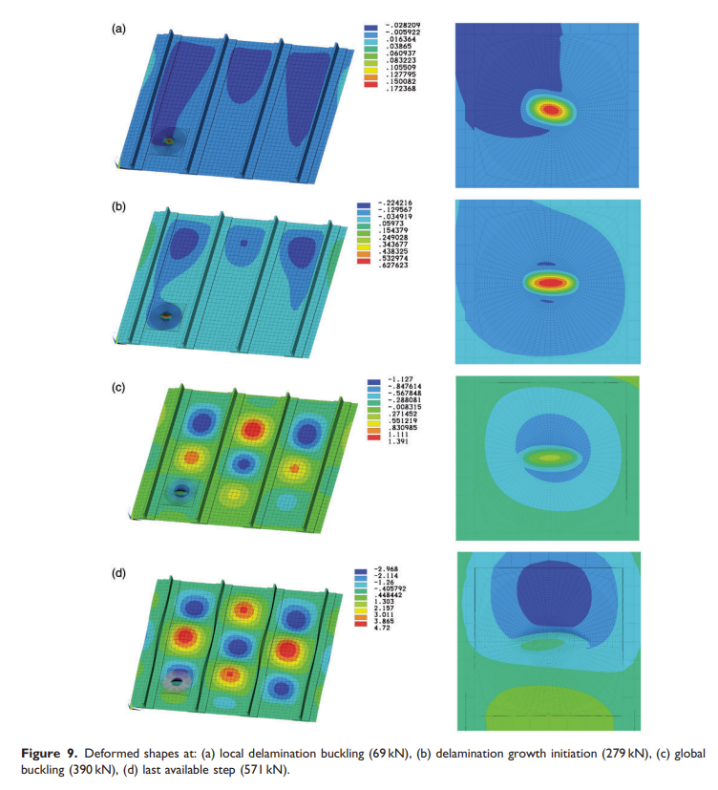
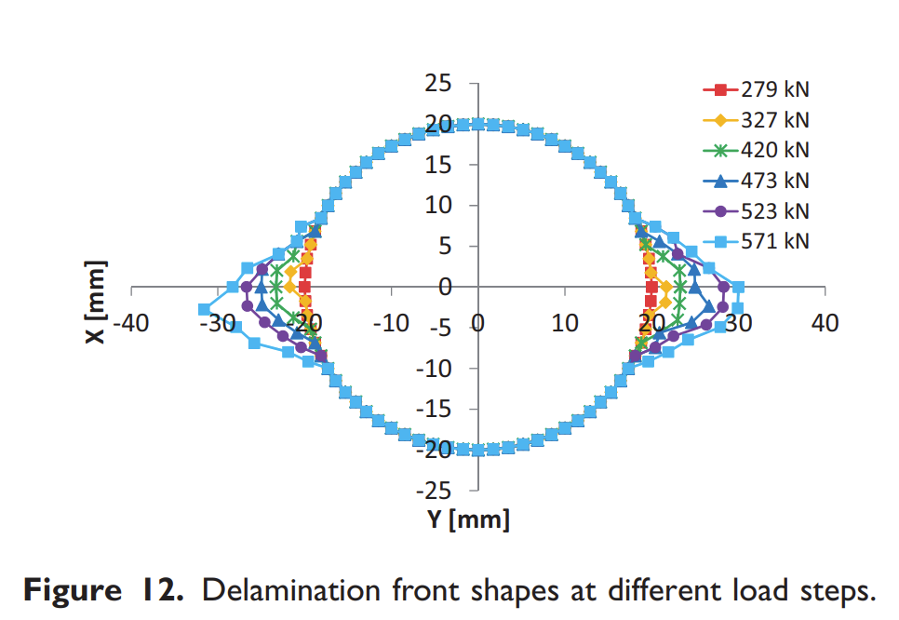
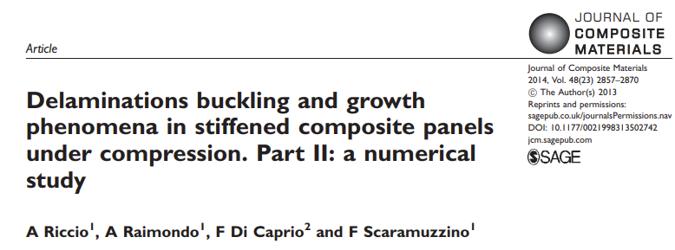
In the past…buckling/growth in stiffened panels

Slide 12
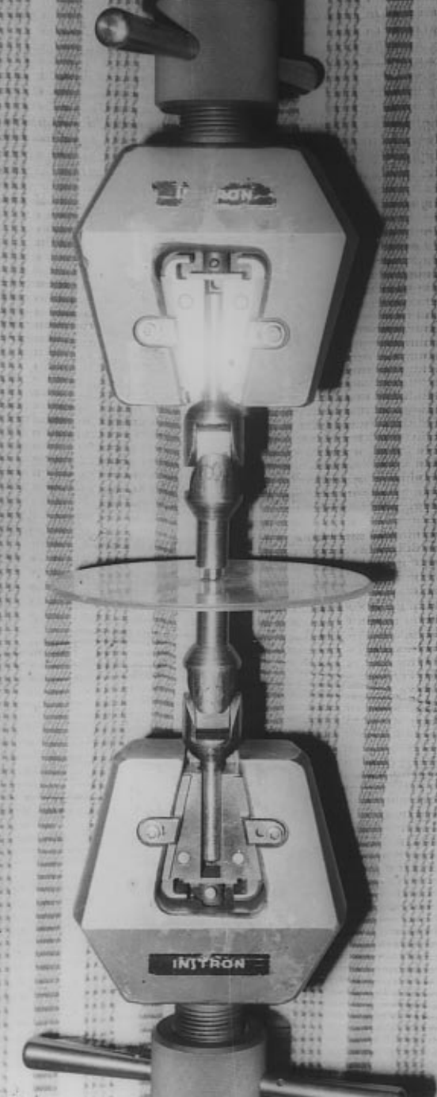
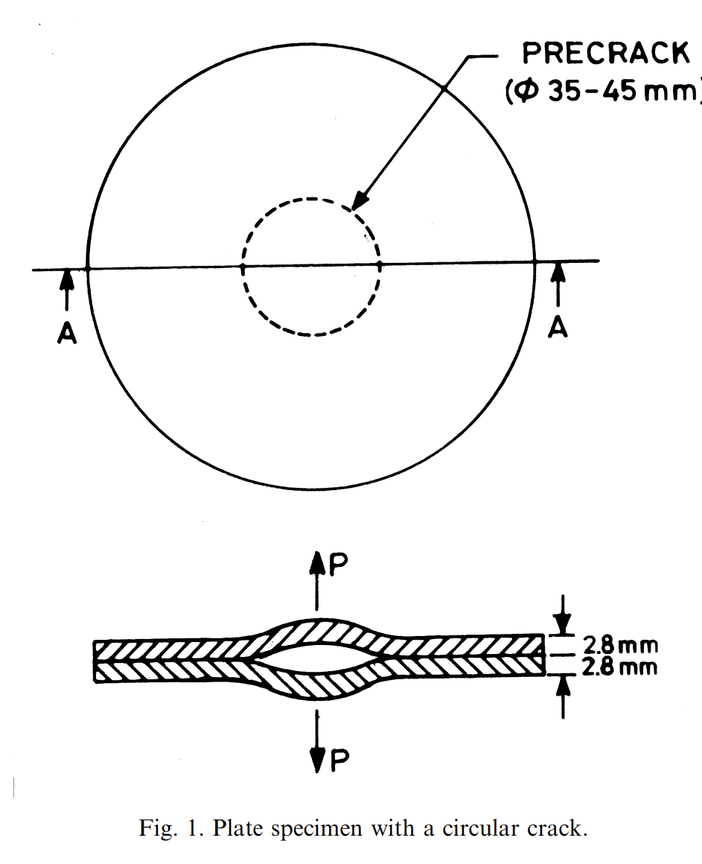
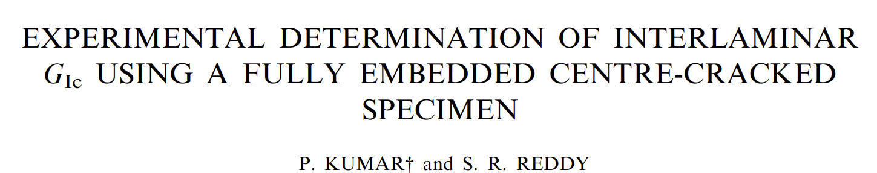
In the past…Mode I 2D opening
Modeling of G: Theoretical formulation neglecting geometrical non-linearities
G (2D) was estimated to be ~33% lower than that estimated from DCB (1D) tests

Slide 13
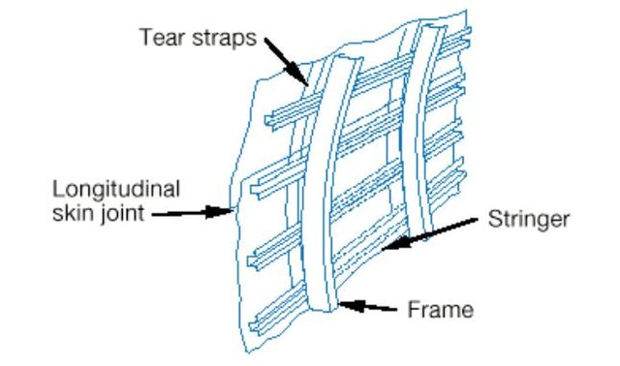
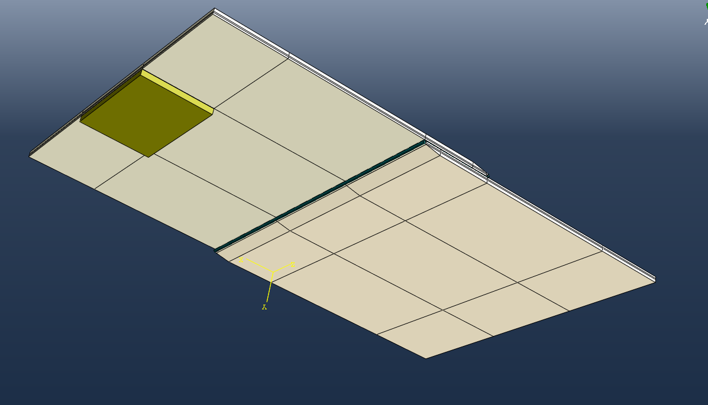
Wide single lap shear joints (WSLS)
Aircraft fuselage longitudinal joint
Low velocity impacted CFRP WSLS joint
Modelling the joint in Abaqus®
Work with ZHAW and Airbus, Germany.
Wide single lap shear joints (WSLS): Element level testing of aircraft fuselage joints/ repairs
CFRP adhesive joints: Impacted, water and ice, under fatigue loading.

Slide 14
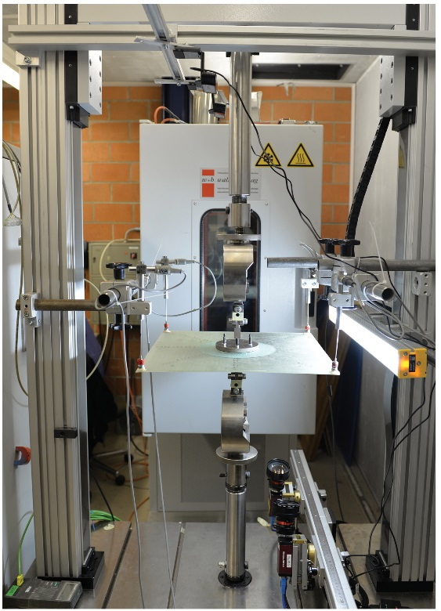
Previously – 2D Mode-I experiments
P
1D (DCB)
P
Delamination growth
P
P
Membrane forces
2D
P
Schematic illustrations of 1D and 2D Mode-I delamination experiments
2D Mode-I experiment

Slide 15
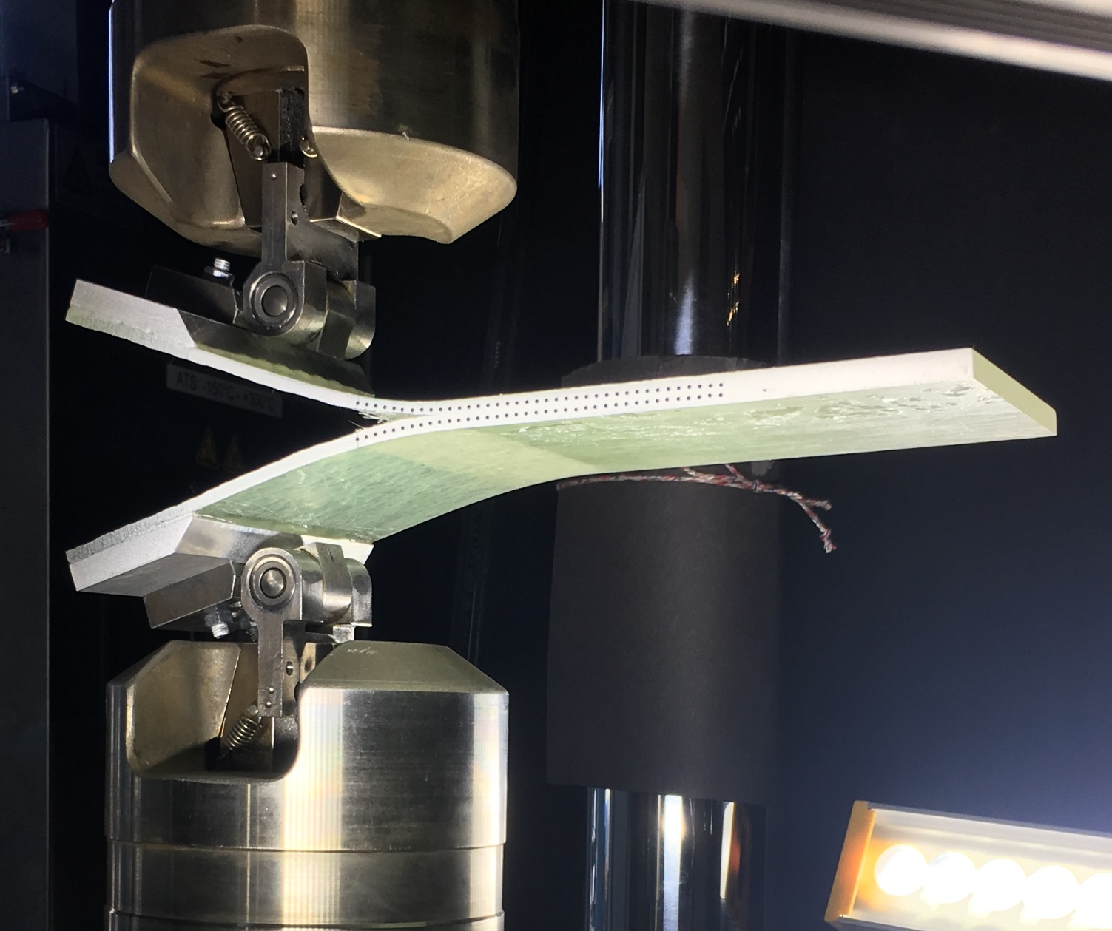
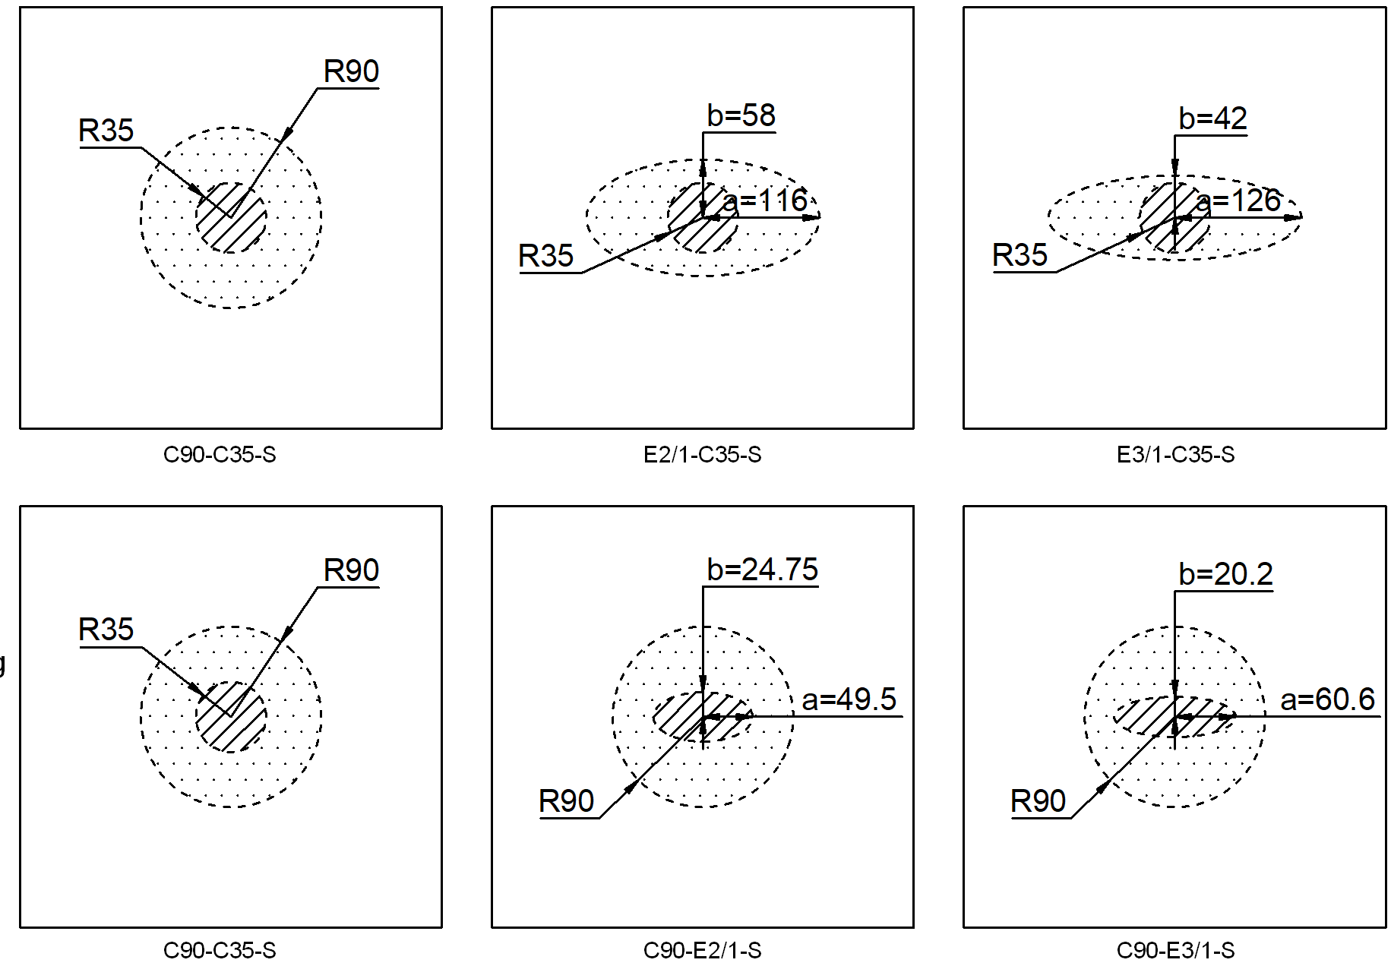
Two-dimensional Mode-I delamination
Background
Fracture in composites in real scenarios is usually two-dimensional (2D)
Example of impact damage on Airbus A330 after horizontal stabilizer accident
Numerical model using cohesive elements with fiber bridging effects considered
Numerical investigation of 2D Mode-I delamination
Effects of:
Pre-crack size
Pre-crack shape
Loading-zone size
Loading-zone shape
Fracture toughness
Stiffness
vs
(a) DCB (Gtot=2.0 kJ/m2) (b) 2D (Gtot=2.8 kJ/m2)
Experimental investigation of 2D Mode-I delamination
… …
Parametric study on 2D Mode-I delamination

Slide 16
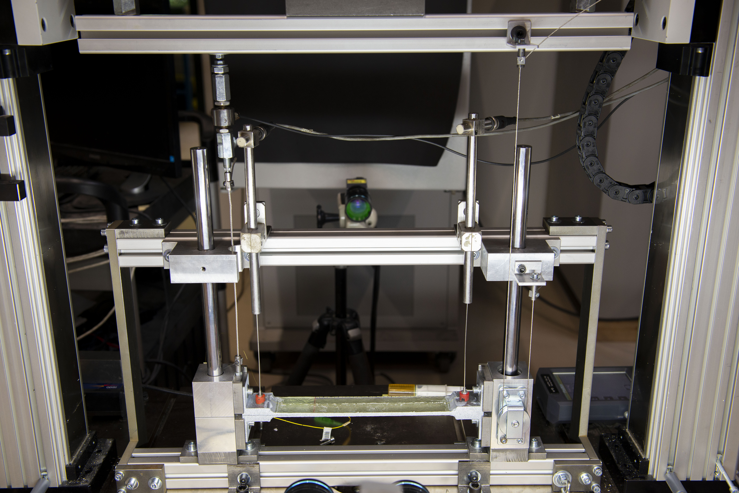
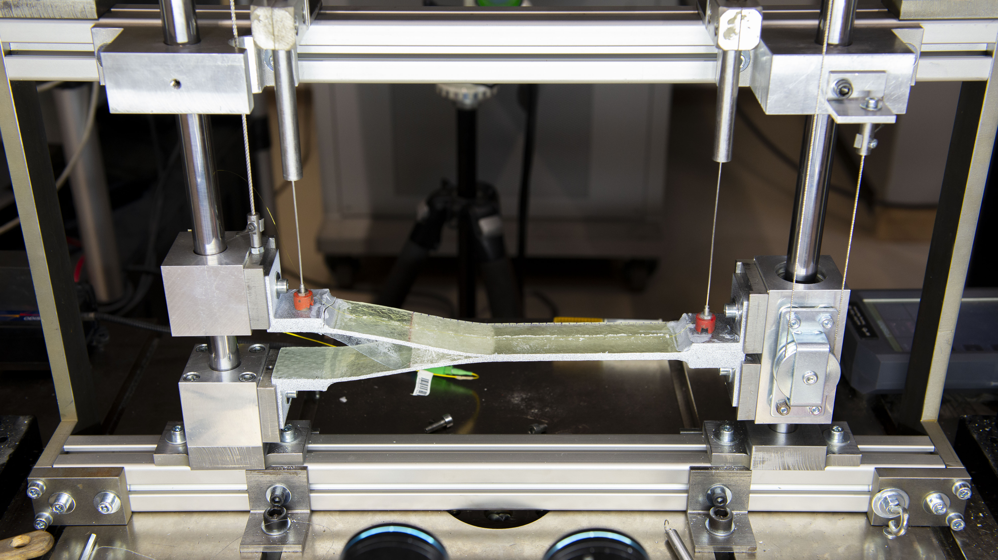
2D Mode I delamination – additional validation

Slide 17
2D Mode-I experiments: What we learned?
P
Main differences from 1D tests
Increasing crack-front length
Constrained boundary at the crack wake
Appearance of membrane stresses
1D (DCB)
P
P
Membrane forces
2D
Resulting 2D effects
Increasing loads even after crack propagation
Enhancement of fiber bridging
Greater G
P
Schematic illustrations of 1D and 2D Mode-I delamination experiments

Slide 18
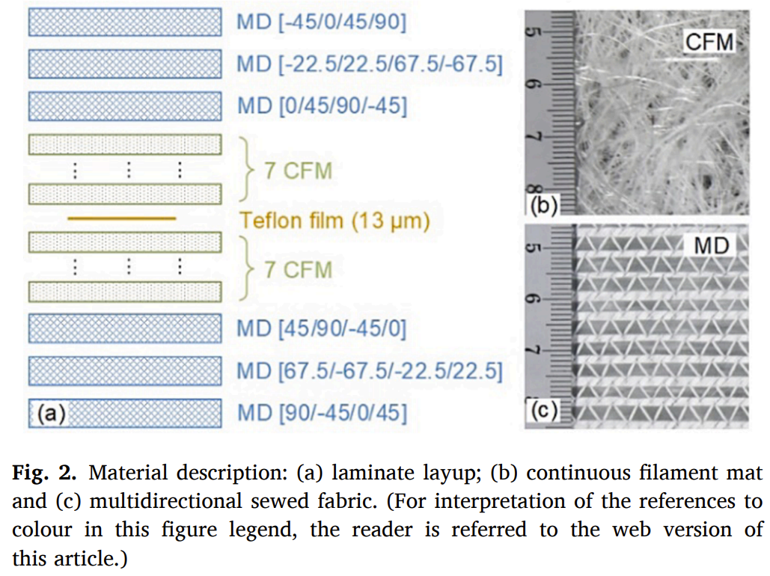
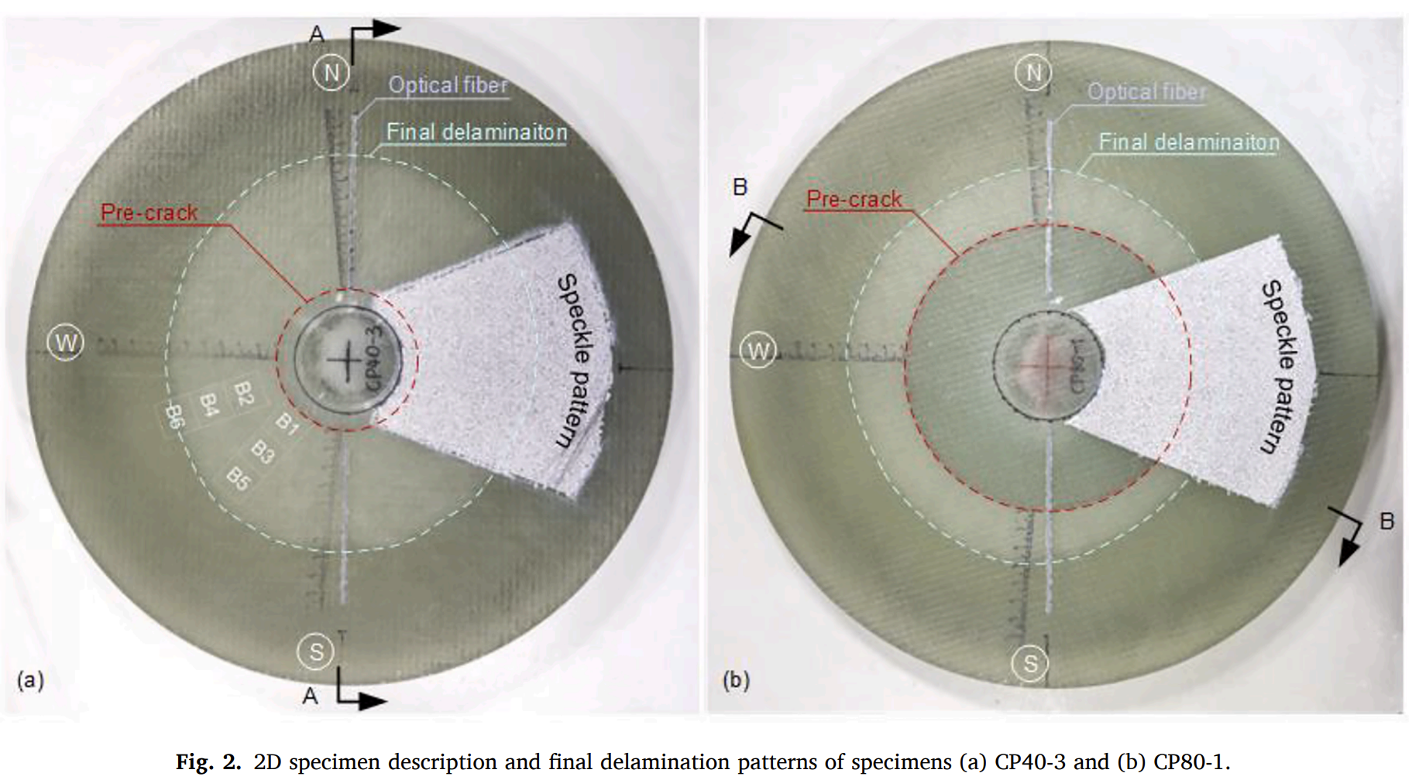
2D Mode II delamination – experimental

Slide 19
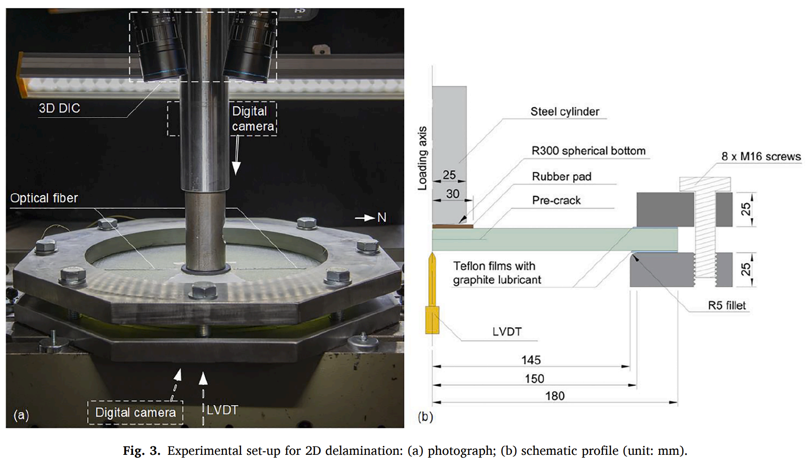
2D Mode II delamination – experimental

Slide 20
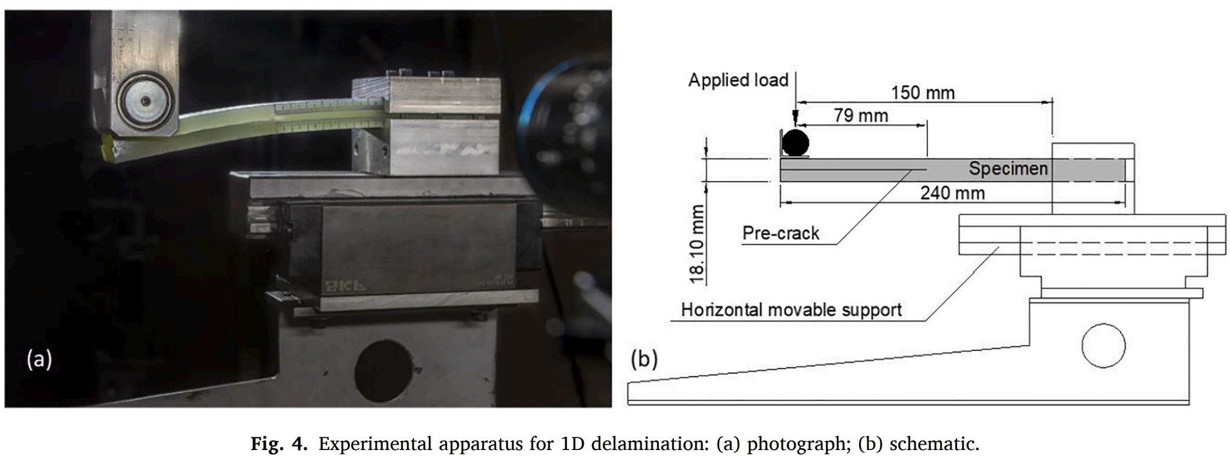
2D Mode II delamination – 1D experiment
Material description

Slide 21
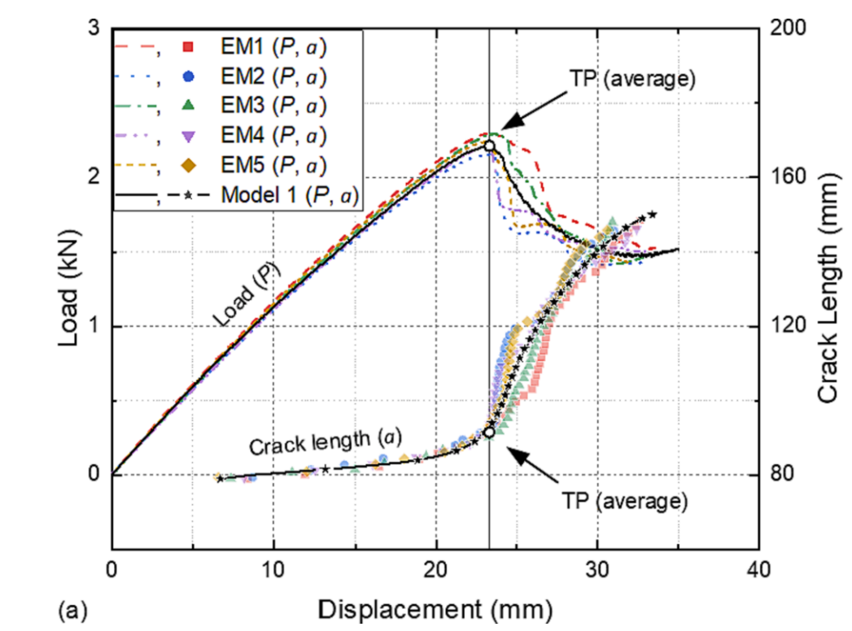
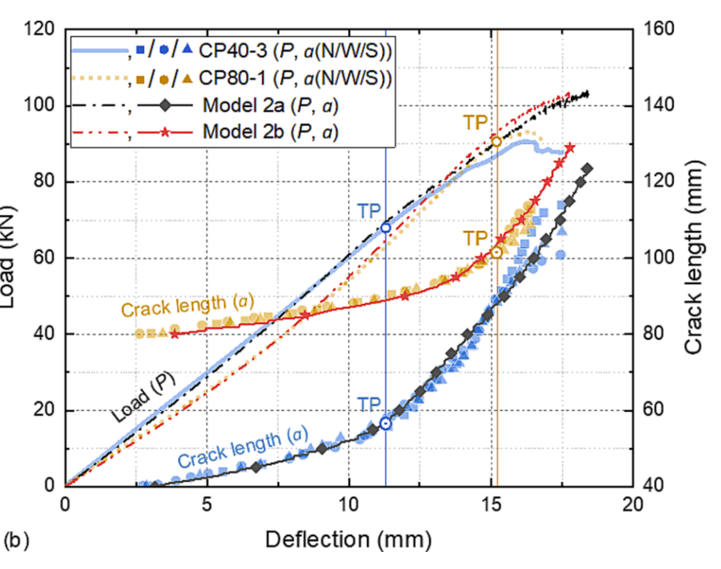
2D Mode II delamination – experimental
Experimental results (a) 1D ELS, (b) 2D plate testing

Slide 22
2D Mode II delamination – numerical modeling

Slide 23
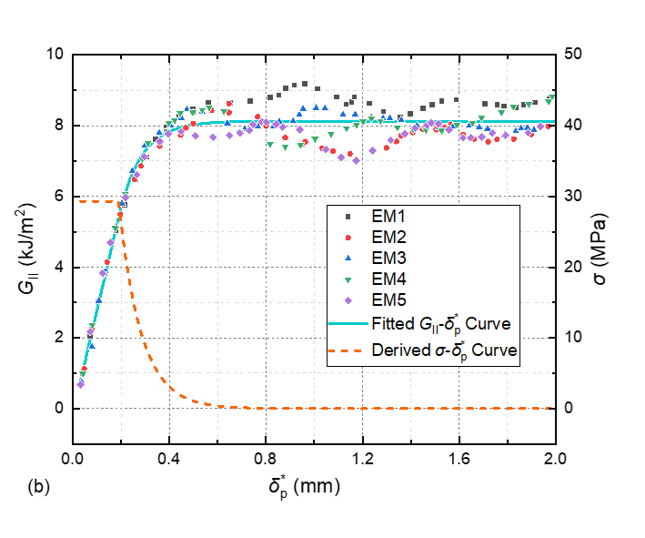

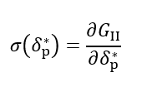
2D Mode II delamination – 1D numerical modeling
Crack sliding at the insert tip in 1D (ELS) experiments
Differentiation
A semi-experimental method was developed to derive the softening traction-separation law based on video extensometer measurements.
G_{II} vs crack sliding at the insert tip and the derivative curves

Slide 24
2D Mode II delamination – 2D numerical modeling
A new cohesive model was developed based on the
experimental estimation of the softening law.
The model considers the three major mechanisms observed in the FPZ during the experiments:
G_{tot}=G_{tip}+G_{m}+G_{br}
Independent variables: {G_{tip}, G_{IIc}, K₀, σ_{c}, σ_{m}, δ₂, δ_{f}}
Iterative fitting for Models 1, 2a and 2b
1D
2D
Schematic cohesive model

Slide 25
2D Mode II delamination – 2D numerical modeling
Segment O-A-B-C represents the matrix plastic damage ahead of the macro-crack tip.
Segment O-A corresponds to the material continuity
before damage onset, where σ increases linearly with δ at a high slope, i.e., penalty stiffness, K₀.
After reaching the Mode-II interfacial strength, σ_{c}, at a separation of δ_{c}, the curve enters a plateau.
The traction drops abruptly at point B with a slope of -K₀, indicating a rapid traction jump.
G_{tot}=G_{tip}+G_{m}+G_{br}

Slide 26
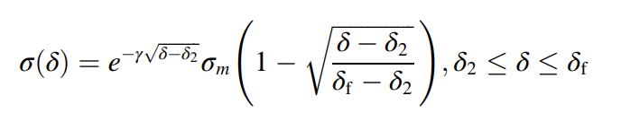
2D Mode II delamination – 2D numerical modeling
Segment C-D represents the microcracking-dominant mechanism, where the separation increases from δ₁ to δ₂ with a constant traction, σ_{m}. This corresponds to the plateau in the experimental softening law, reflecting the mean shear traction over multiple microcracks.
Segment D-E represents the fiber (bundle) bridging-dominant mechanism, which appears after the coalescence of the microcracks at the wake of the microcracking zone.
Segment D-E is described using the relationship at the right, which has been proven effective in modeling the bridging behavior in both 1D and 2D Mode-I delamination:
G_{tot}=G_{tip}+G_{m}+G_{br}

Slide 27
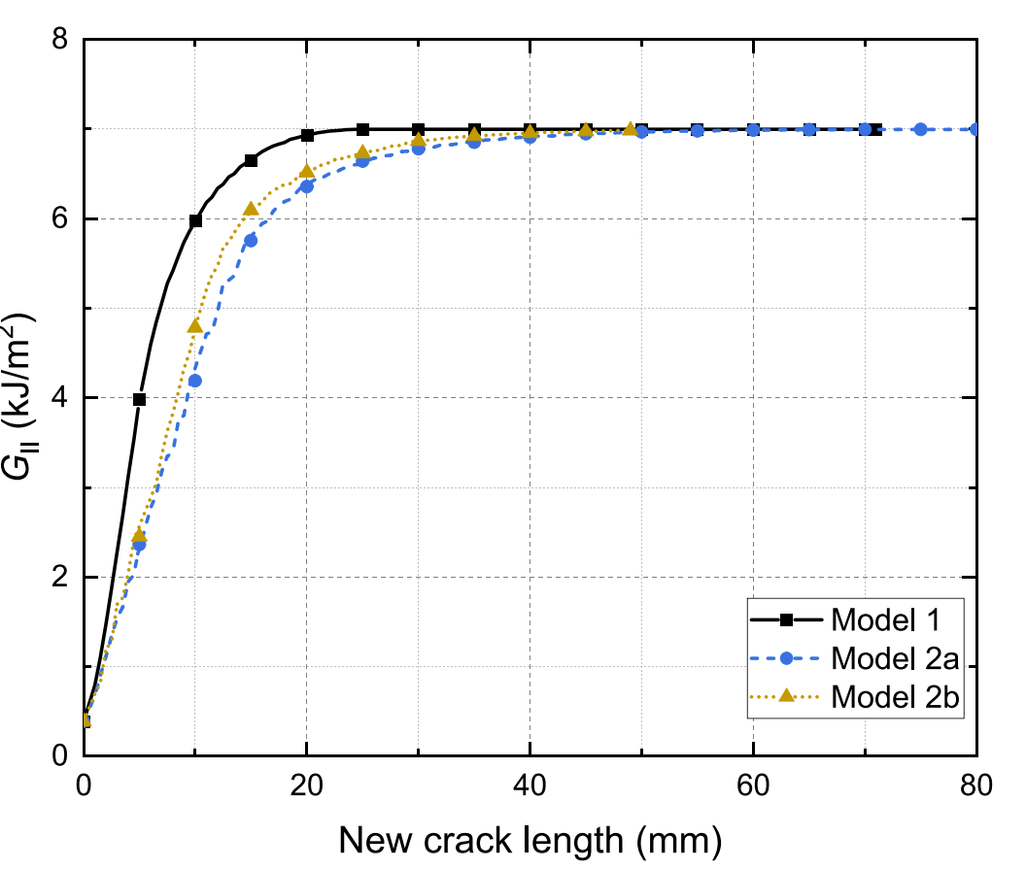
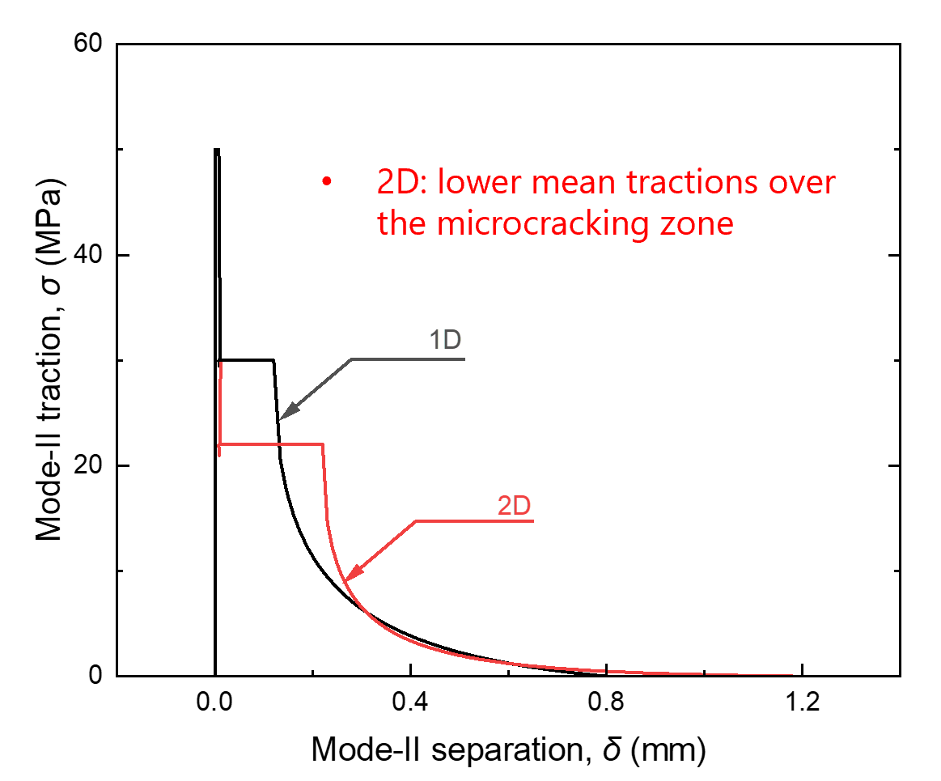
2D Mode II delamination – 1D numerical modeling
Modeling results – Both 1D and 2D
Detailed cohesive laws

Slide 28
2D Mode II delamination – membrane stresses
Deformed section of the 2D model
U: upper sub-laminate;
L: lower sub-laminate.
Radial membrane stresses along r axis (a=100 mm)
Model 2a: a₀=40 mm;
Model 2a: a₀=80 mm.
Stretching over the microcracking zone introducing extra opening component onto the microcracks
Similar membrane stress levels for Models 2a and 2b (stabilized values during crack propagation)

Slide 29
2D Mode II delamination – numerical analysis
A new Mode-II cohesive law considering microcracking and fiber bridging was developed using a semi-experimental approach.
The analysis resulted in two distinct cohesive laws, one for the 1D case and another for the 2D cases.
The assumption of equal G_{tip} in 1D and 2D Mode-I and Mode II delamination was validated by comparisons between the numerical and experimental results regarding the crack initiation displacement (deflection).
G_{IIc} value was similar for 1D and 2D regardless of the difference in the traction-separation response. This contradicts the results in Mode-I (1D, 2D) delamination and raises more questions for future investigations.

Slide 30
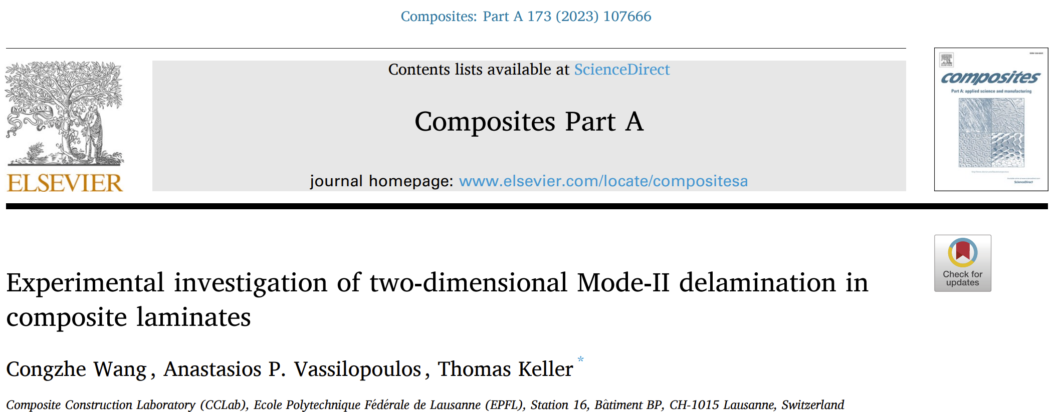
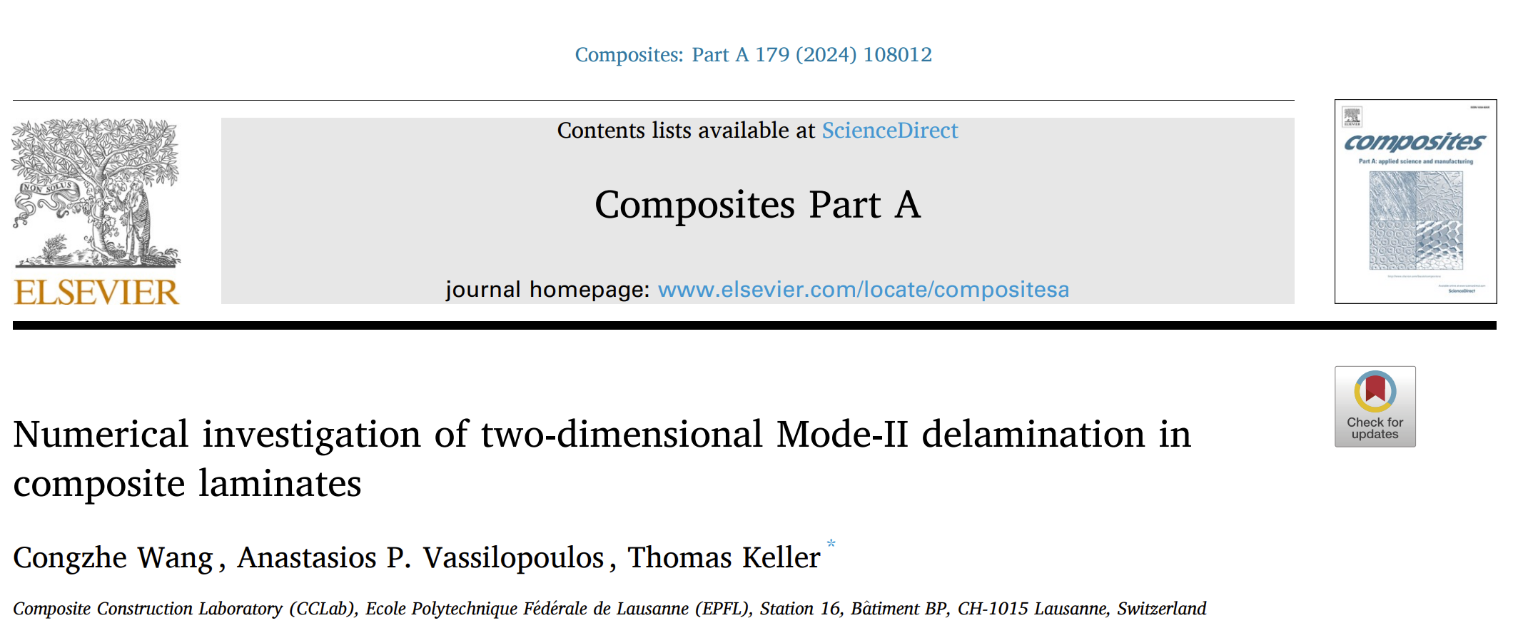
2D Mode II delamination - publications

Slide 31

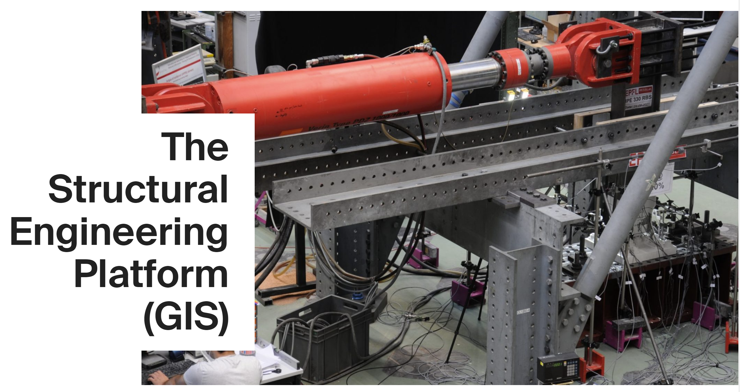
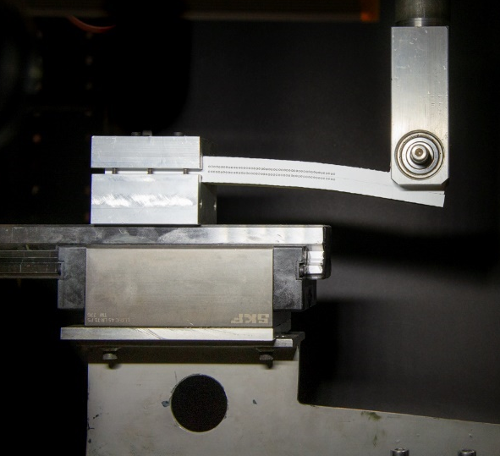
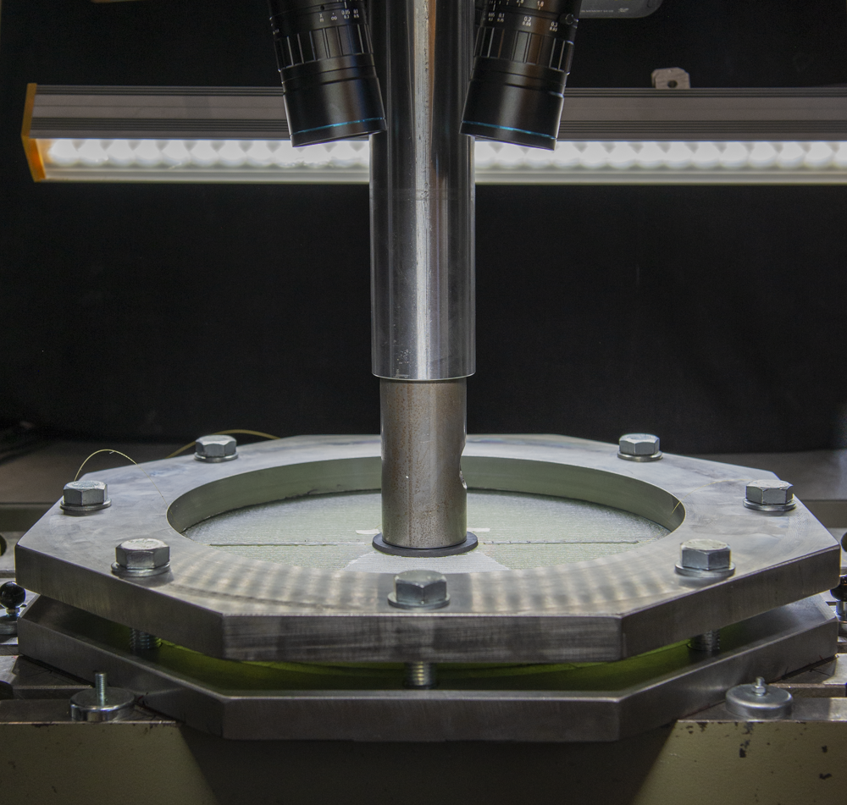
Acknowledgments
“Fatigue and fracture simulation methods for engineering structures made of polymeric composites” (200020_185005)

